Slide 1


Project Code: MEx
Hanoi, September 1st 2017

Slide 2



Team Members
Supervisor
Mr. HOANG XUAN SON
Do Cao Phong
Pham Minh Hoang
Luyen Bao Anh
Le Xuan Huong
Phung Duc Luat
Dang Ngoc Tu
Software Developer
Hardware Developer
Team leader
Technical Leader
QA Leader
Test Leader

Slide 3
Presentation Agenda
1
Introductions
Project Management
2
3
Implementation
Product Demo
4
5
Question and Answer

Slide 4
1. INTRODUCTION
How do we get the problem ?
How did the idea come to us ?

Slide 5

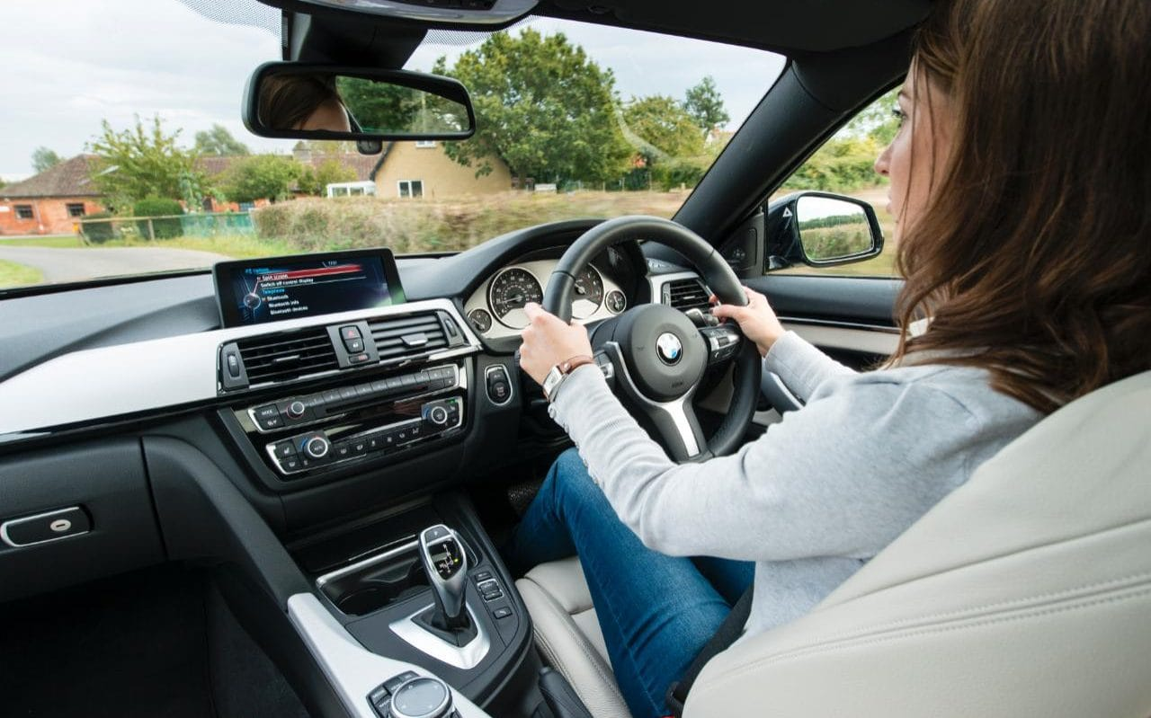
THE PROBLEM

Slide 6
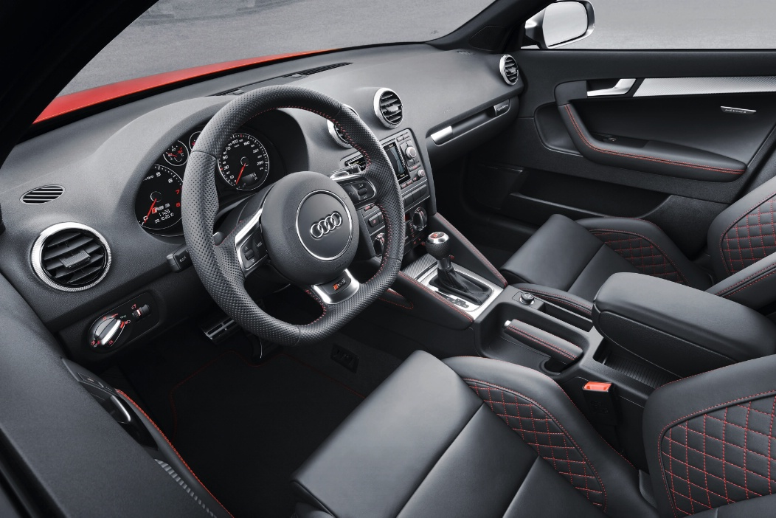

IDEA
Create a remote control automobile model
Make a remote controller to simulate driving
Develop an application with Virtual Reality Technology to bring new experience

Slide 7
2. PROJECT MANAGEMENT
System development plan
Risk
Management
plan
Development
tools

Slide 8
System Development Plan
Process Model
Requirement
Implementation
Planning
Deployment
Evaluation
Testing
Iterative and Incremental Software Process Model

Slide 9
System Development Plan
Team working
01
Working everyday
Spend 3 hours per day and 5 days per week.
02
Meeting every week
At FPT University Hoa Lac Campus
03
Keeping in touch on social network
Send report at Facebook and join regular meeting at Skype
02
Getting feedback from supervisor
Meeting supervisor once per week

Slide 10
System Development Plan
Project Plan
Chờ tú xem lại project plan

Slide 11
















Development Tools
4
3
2
Operating Systems
Programming Languages
Electronic Design Tools
Others:

Slide 12
Risk management plan
Chờ a Luật chọn lọc risk

Slide 13
3. IMPLEMENTATION
System Architecture Design
Software & Hardware Design
Hardware device list
Mechanism Design

Slide 14
System Architecture Design
Android
Client
Raspberry Pi 3
Microprocessor
Wi-Fi module
Client App
Camera
Sensors
Servo
DC Motors
Motor Driver
Power supply
Automobile
Model
Wi-Fi module
Microcontroller
Equip
Remote
Controller
Pedals
Steering wheel
Server-side
Client-side

Slide 15
Software Design
Server-side process
Start
Open HTTPServer port 8012
Open socket port 8011
Decrypt request and try to execute
F
Is the request is disconnect?
T
Wait for a client connect
F
Receive request
Wait for a client connection
There are a request connect?
Have a client connect?
F
T
T
T
This device is Android?
F
Android device are in VR mode?
T
Close connection to device
Get authentication
information
Send response
F
F
Can authenticate device?
T
The limitation of device is reached?
T

Slide 16
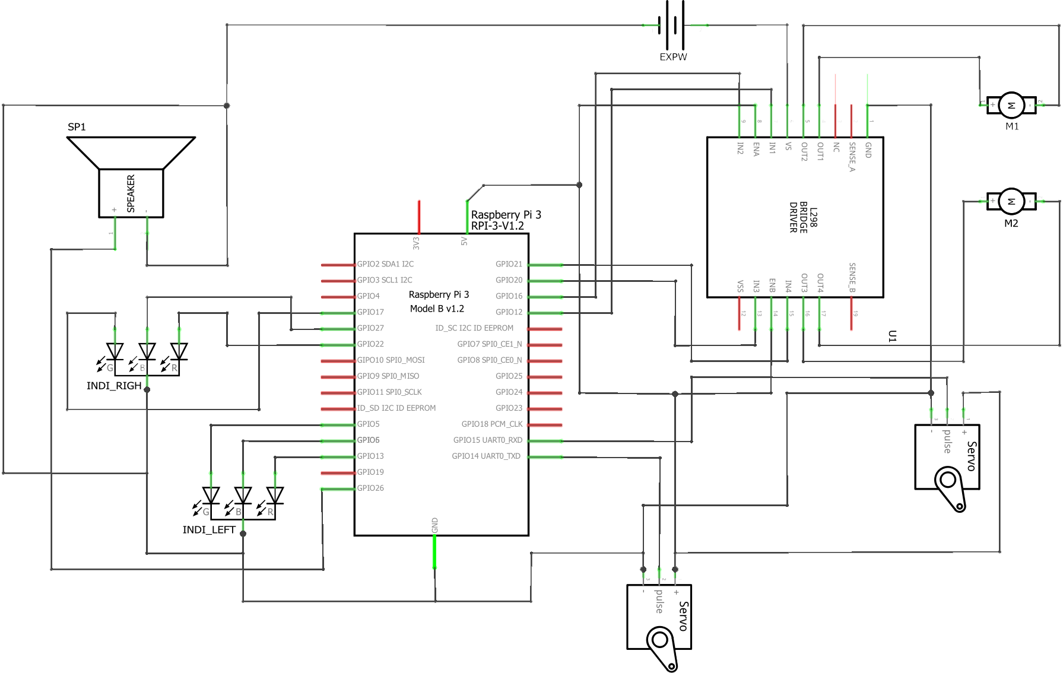
Hardware Design
Schematic

Slide 17
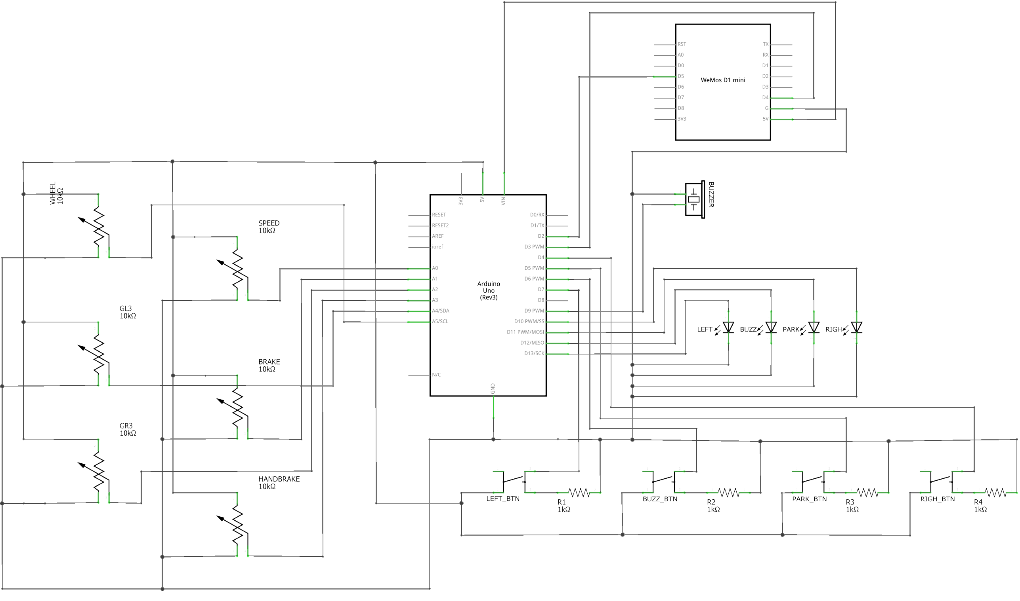
Hardware Design
Schematic (continue)

Slide 18
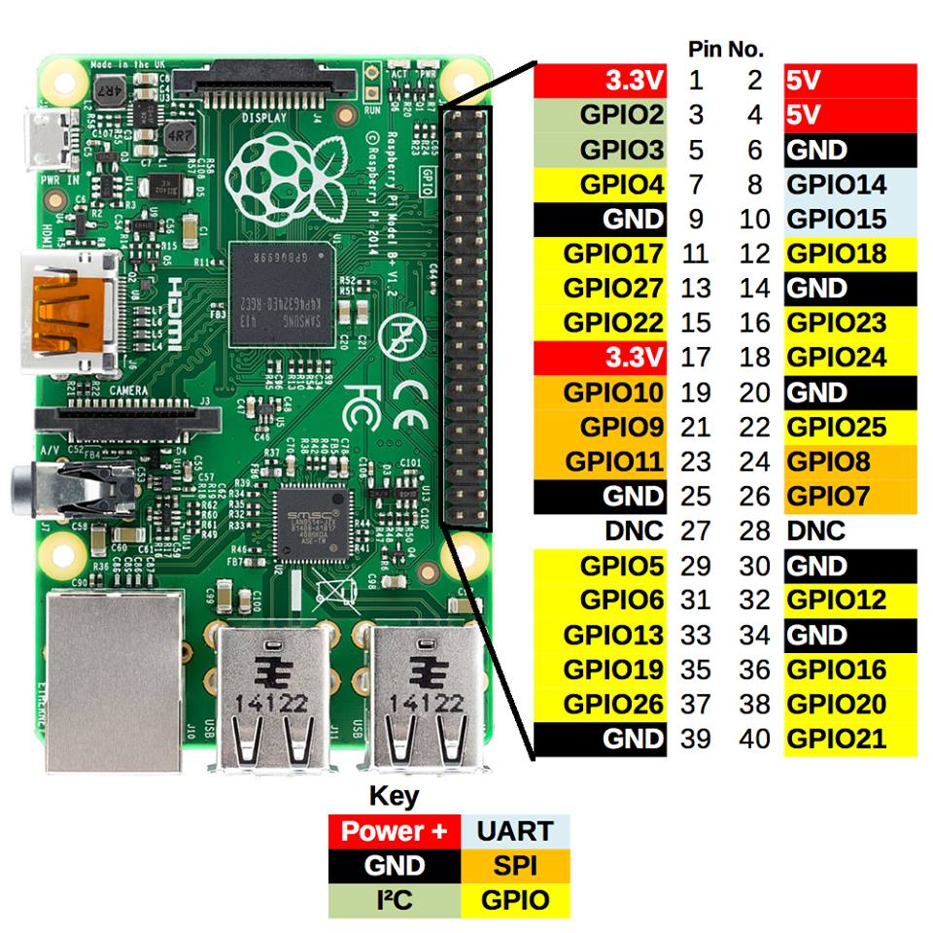
Hardware Devices
Raspberry Pi 3 Model B
Processor | Broadcom BCM2837 SoC with a 1.2 GHz 64-bit quad-core ARM Cortex-A53 processor, with 512 KB shared L2 cache
GPU | Broadcom VideoCore IV @ 250 MHz OpenGL ES 2.0 MPEG-2 and VC-1
Memory | 1GB
Operating System | Boots from Micro SD card, running a version of the Linux operating system or Windows 10 IoT
Network | 10/100 Mbit/s Ethernet, 802.11n wireless built-in, Bluetooth 4.1
GPIO Connector | 40-pin 2.54 mm (100 mil) expansion header: 2x20 strip Providing 27 GPIO pins as well as +3.3 V, +5 V and GND supply lines

Slide 19
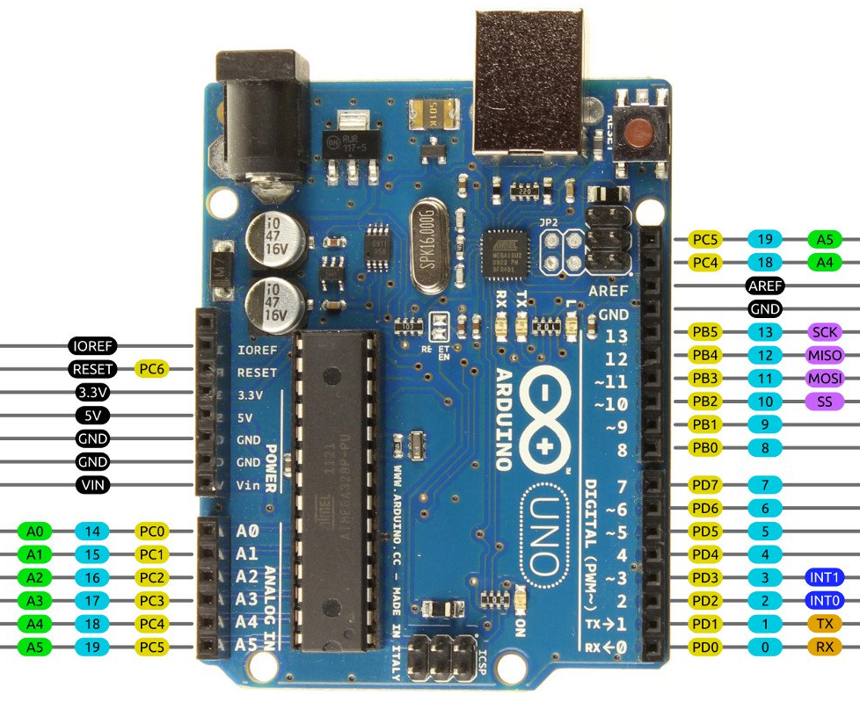
Hardware Devices
Arduino Uno R3
Microcontroller | ATmega328
Architecture | AVR
Operating Voltage | 5V
Flash memory | 32KB of which 0.5 KB used by bootloader
SRAM | 2KB
Clock Speed | 16 MHZ
EEPROM | 1 KB
DC Current per I/O pins | 40 mA on I/O pins; 50 mA on 3.3V pin
Input Voltage | 7 – 12 V
Digital I/O pins | 20
Analog I/O Pins | 6
Board Dimensions | 68.6mm x 53.4mm

Slide 20
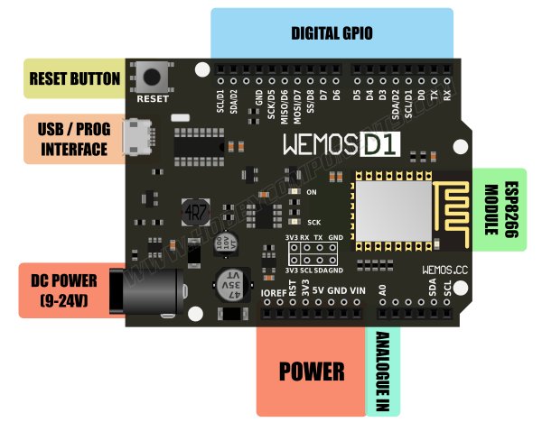
Hardware Devices
WeMos D1
Microcontroller | ESP8266
Operating Voltage | 3.3V
Input Voltage Range | 9V to 24V
Output | 5V at 1A max
Digital I/O pins | 11
Analog input pins | 1
Flash Memory | 4MB
Board Dimensions | 68.6mm x 53.4mm
Weight | 21.8g

Slide 21
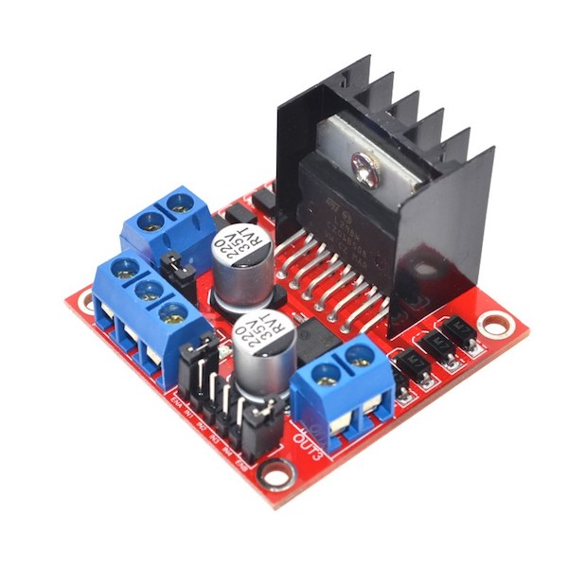
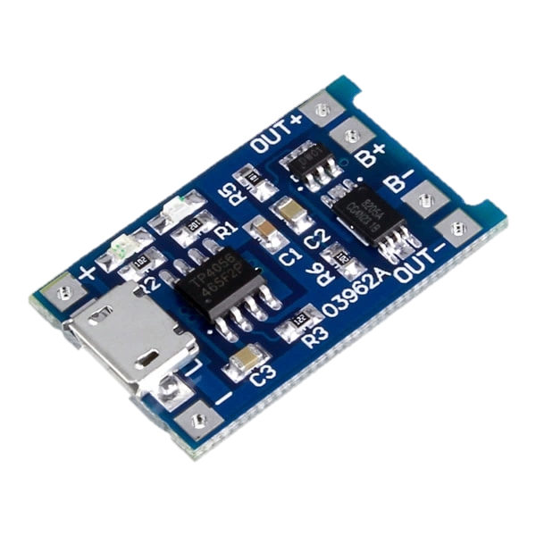
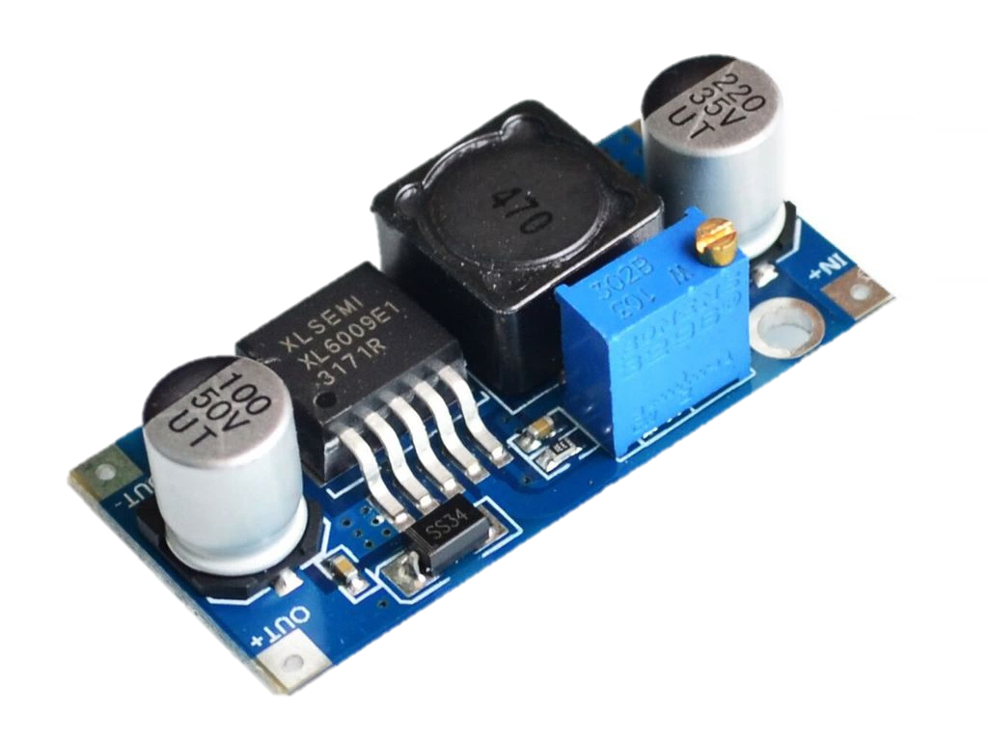
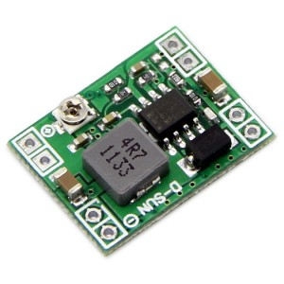
Hardware Devices
Other modules
L298N
Motor Controller
TP4056
Charging circuit
XL6009
Switching Current Boost
MP1584
Step-down Regulator
Power supply | +5 V ~ +35 V
Peak output current | 2A/channel
Logic power output | +5 V ~ +7 V
Logic current | 0 ~ 36mA
Max power | 20W(Temperature 75 ℃)
Working temperature | -25 ℃ ~ +130 ℃
Input voltage | 4.5 ~ 5.5V
Full charge voltage | 4.2V
Working temperature | -10­­ºC ~ +85ºC
Charging Current | 1A
Input voltage | 3.2V ~ 32V
Output Voltage | 4V ~ 38V
Rated output current | 3A
Peak Output Current | 4A
Conversion efficiency | Up to 94%
Voltage input | 4.5-28V
Voltage output | 5V
Current output | 3A
Size | 22x17mm

Slide 22
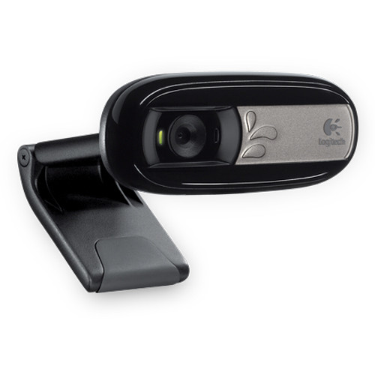
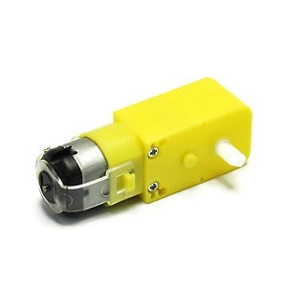
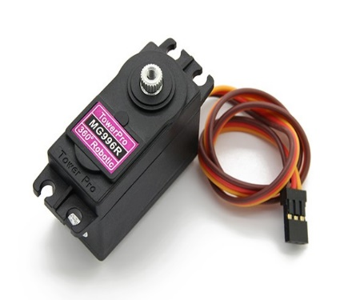
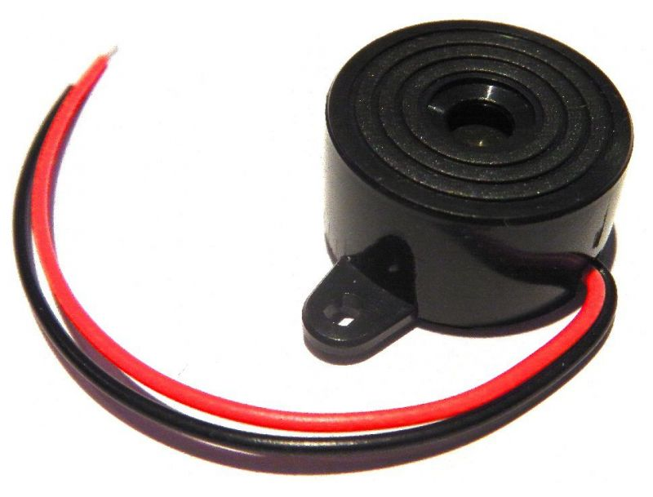
Hardware Devices
Equipments
1
2
Gear speed-reducer
DC Motor
Logitech C170
2
1
Servo MG996
Buzzer

Slide 23
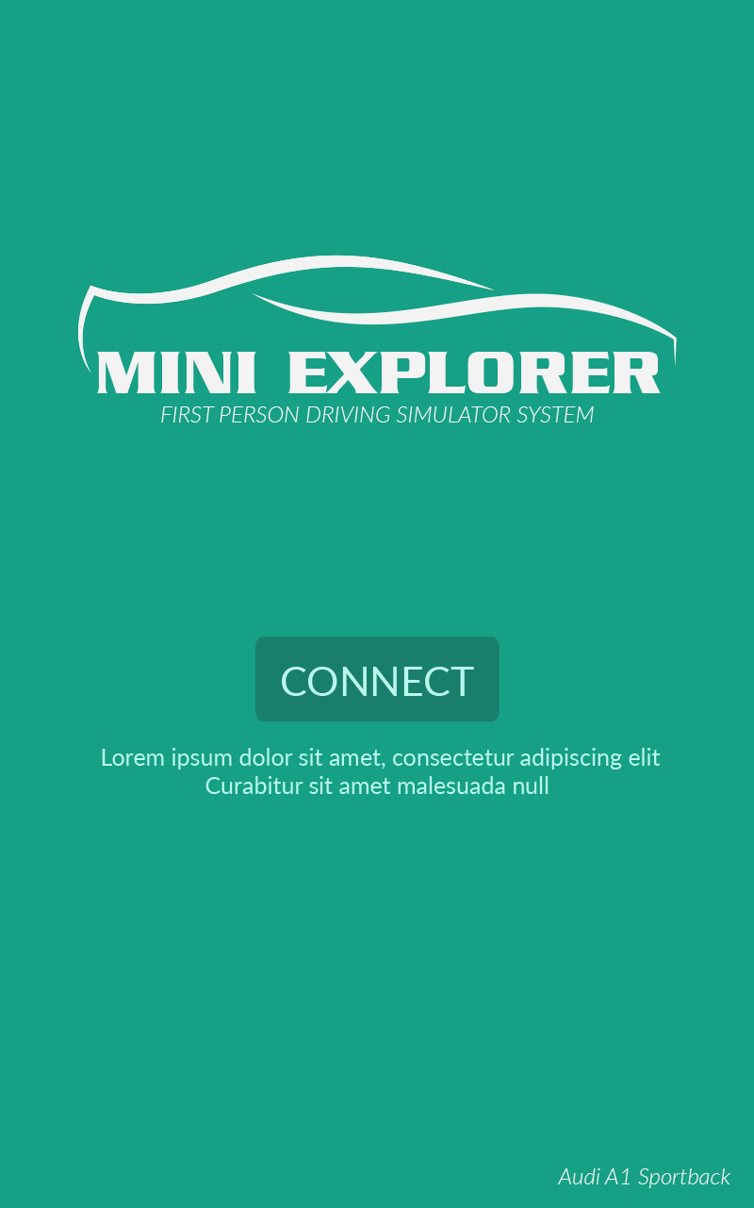
Android Client Application
Welcome Screen
Introduce to device connection

Slide 24









Android Client Application
Controller Mode
Control with streaming media
from Automobile Model
Virtual Reality Mode
Experience the first person view
with VR Glasses

Slide 25
Application Design
Start
End
F
Welcome Screen
Is Wi-Fi
Available?
Disconnect
To Server
T
T
Try to connect to server
Get Server Address
Get data in
Control Mode
The request is
Disconnect?
F
Send data
To Server
F
Connect to
server successful?
T
Control Mode View
Receive data from server
F
Change to
VR Mode?
T
VR Mode
View
Get data in
Control Mode
Tab Back

Slide 26
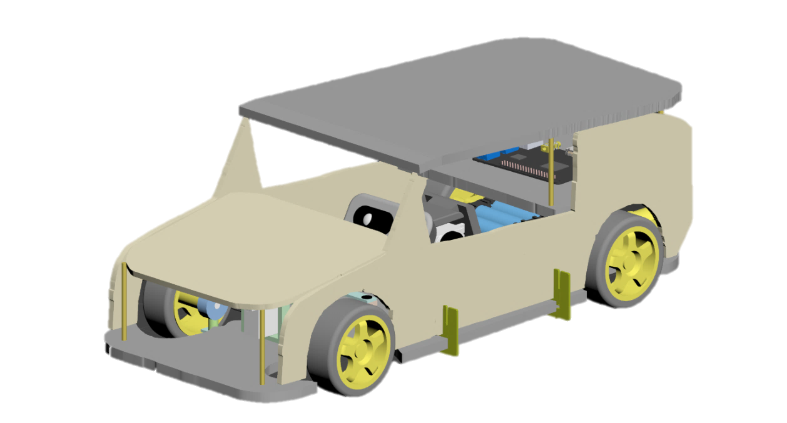
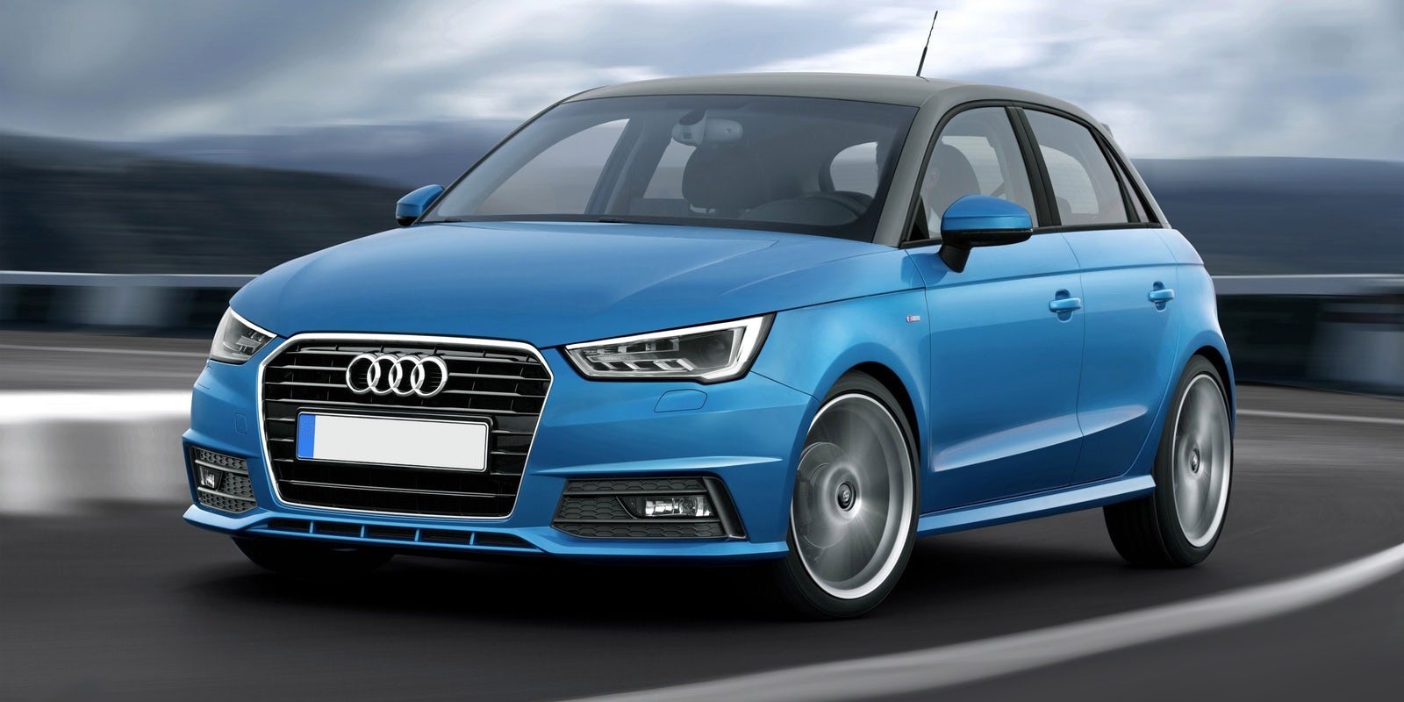
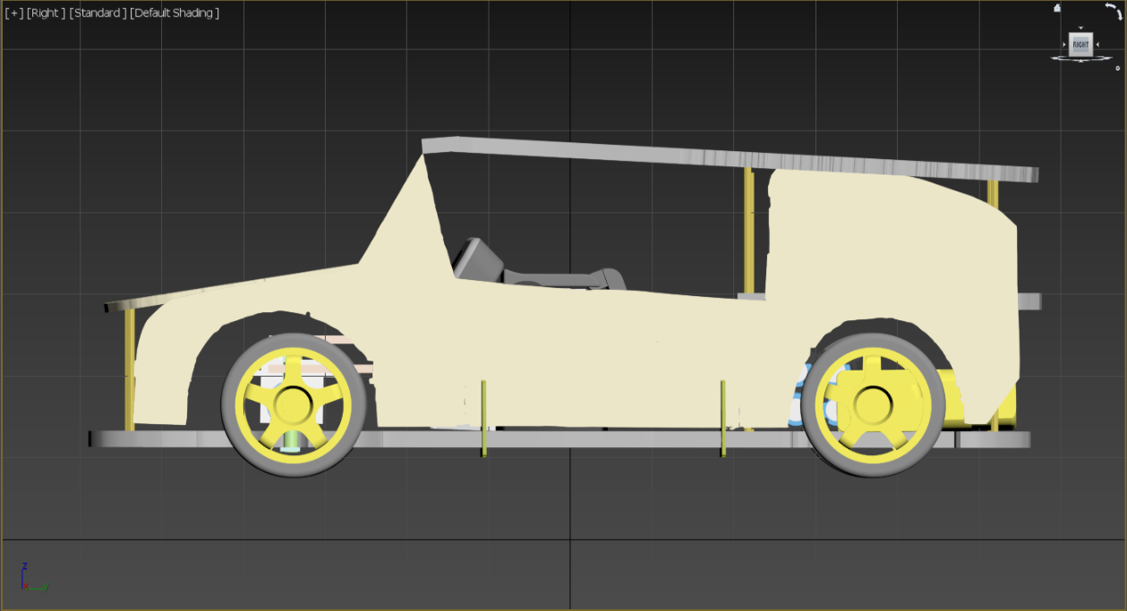
Automobile Model
Concept design

Slide 27
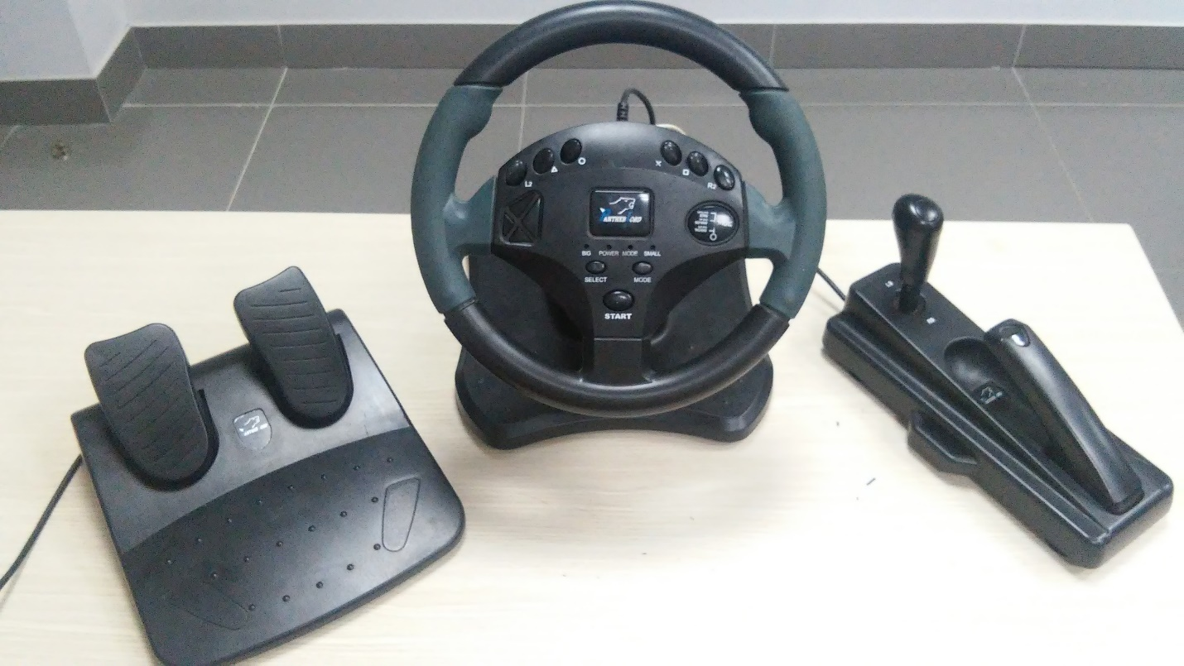
Remote Controller
Arduino & WeMos inside
Collect data from Rotary resistance
and Button

Slide 28
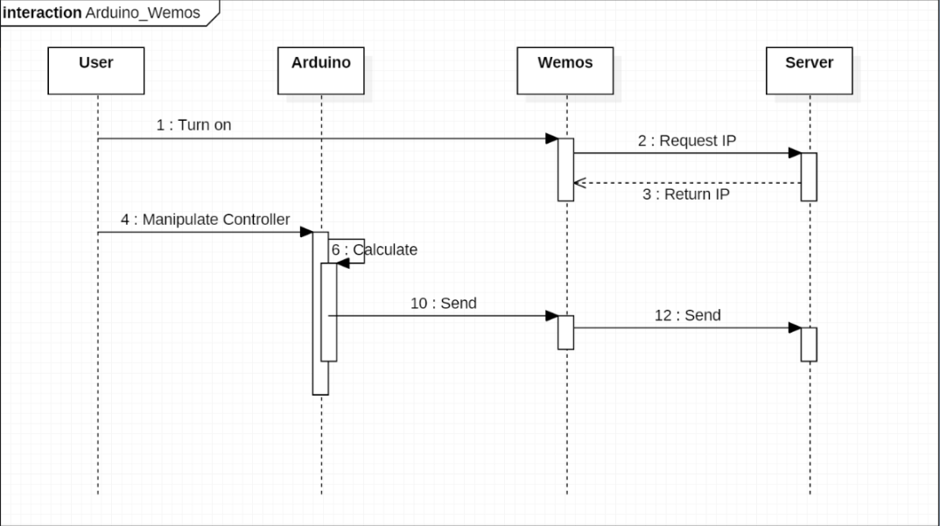
Firmware Design

Slide 29


Future Work

Slide 30
PRODUCT DEMO

Slide 31
QUESTION AND ANSWER

Slide 32

THANK YOU

